Slide 1
Cryptography (2021 Fall) discrete logarithm, CDH, DDH, drawbacks of private-key, key exchange, Diffie-Hellman key exchange, man-in-the-middle attack
LiangFeng Zhang
zhanglf@shanghaitech.edu.cn
SIST, ShanghaiTech

Slide 2
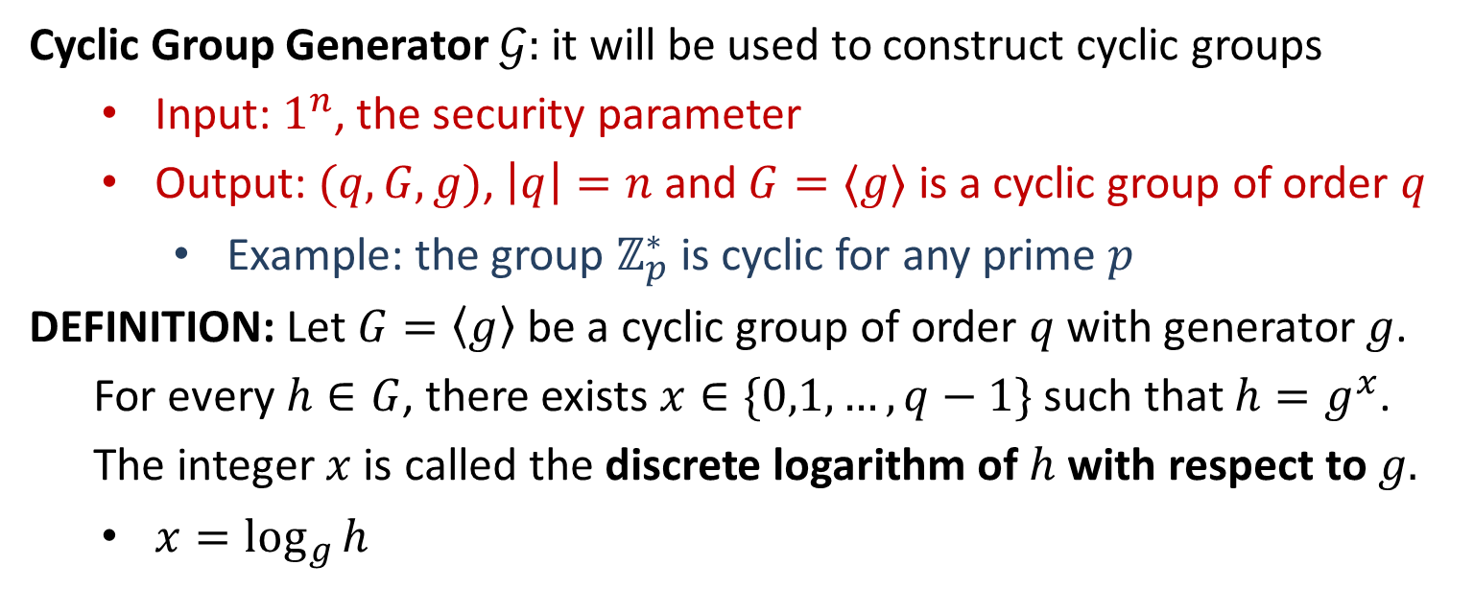
Discrete Logarithm
Cyclic Group Generator $𝒢:$ it will be used to construct cyclic groups
Input: $1^{n}$, the security parameter
Output: $(q,G,g)$, $\left|q\right|=n$ and $G=〈g〉$ is a cyclic group of order $q$
Example: the group $ℤ_{p}^{∗}$ is cyclic for any prime $p$
DEFINITION: Let $G=〈g〉$ be a cyclic group of order $q$ with generator $g$.
For every $h∈G$, there exists $x∈\{0,1,…,q−1\}$ such that $h=g^{x}$.
The integer $x$ is called the discrete logarithm of $h$ with respect to $g.$
$x=\log_{g}{h}$

Slide 3






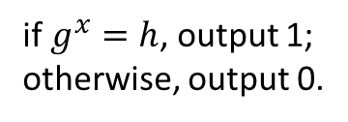
Discrete Logarithm
Discrete Logarithm Experiment $DLog_{𝒜,𝒢}(n)$: $n$-the security parameter
DEFINITION: We say that the discrete logarithm problem is hard
relative to $𝓖$ if for all PPT algorithms $𝒜,$there is a negligible
function $negl$ such that
$$\operatorname{Pr}\left[DLog_{𝒜,𝒢}(n)=1\right]≤negl(n)$$
best known algorithm: $exp⁡(O({\left(\ln{q}\right)}^{1/3}{\left(\ln{\ln{q}}\right)}^{2/3}))$
$$\left(q,G,g\right)←𝒢\left(1^{n}\right)$$
$$h←G$$
$$(q,G,g,h)$$
$$x$$
if $g^{x}=h$, output 1;
otherwise, output 0.
challenger
$$𝒜$$

Slide 4
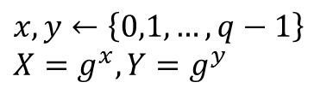



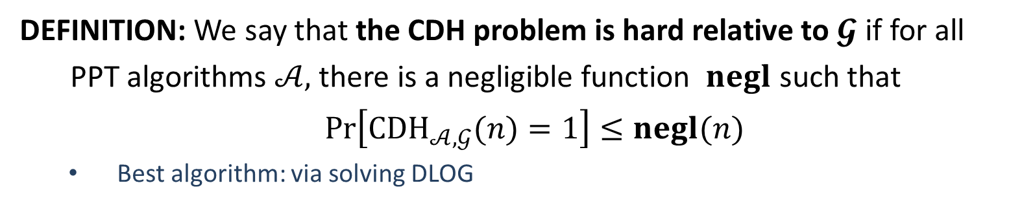

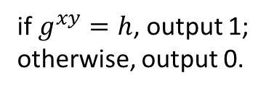
CDH
The CDH (Computational Diffie-Hellman) Experiment ${CDH}_{𝒜,𝒢}(n)$:
$$\left(q,G,g\right)←𝒢\left(1^{n}\right)$$
$$x,y←\left\{0,1,…,q−1\right\}$$
$$X=g^{x}, Y=g^{y}$$
$$(q,G,g,X,Y)$$
$$h$$
if $g^{xy}=h$, output 1;
otherwise, output 0.
challenger
$$𝒜$$
DEFINITION: We say that the CDH problem is hard relative to $𝓖$ if for all
PPT algorithms $𝒜,$there is a negligible function $negl$ such that
$\operatorname{Pr}\left[{CDH}_{𝒜,𝒢}(n)=1\right]≤negl(n)$
Best algorithm: via solving DLOG

Slide 5

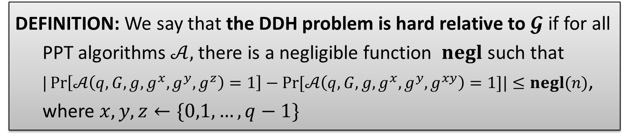

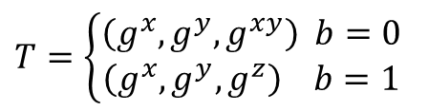



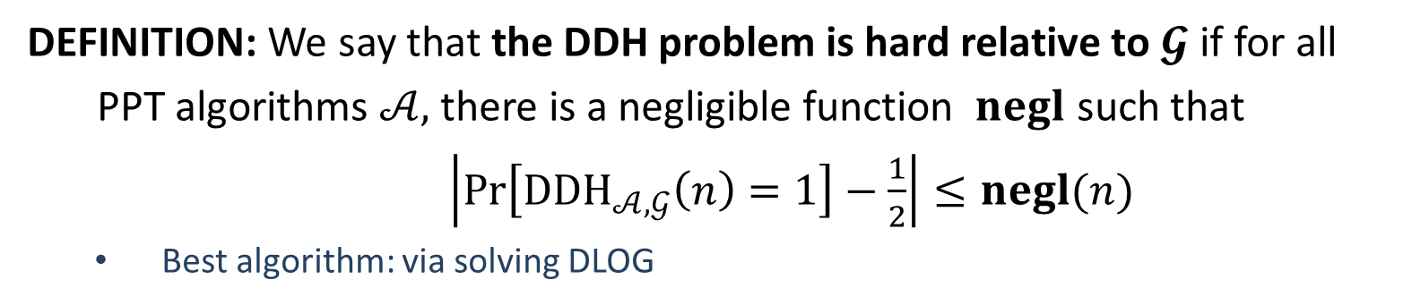

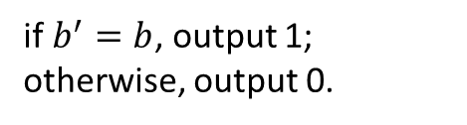
DDH
The DDH (Decisional Diffie-Hellman) Experiment ${DDH}_{𝒜,𝒢}(n)$:
$$\left(q,G,g\right)←𝒢\left(1^{n}\right)$$
$$x,y,z←\left\{0,1,…,q−1\right\}$$
$$b←\{0,1\}$$
$$T=\left\{\begin{aligned}\left(g^{x}, g^{y},g^{xy}\right) b=0 \\ \left(g^{x},g^{y},g^{z}\right) b=1\end{aligned}\right.$$
$$(q,G,g,T)$$
$$b′$$
if $b^{′}=b$, output 1; otherwise, output 0.
challenger
$$𝒜$$
DEFINITION: We say that the DDH problem is hard relative to $𝓖$ if for all
PPT algorithms $𝒜,$there is a negligible function $negl$ such that
$\left|\operatorname{Pr}\left[{DDH}_{𝒜,𝒢}\left(n\right)=1\right]−\frac{1}{2}\right|≤negl(n)$
Best algorithm: via solving DLOG
DEFINITION: We say that the DDH problem is hard relative to $𝓖$ if for all
PPT algorithms $𝒜,$there is a negligible function $negl$ such that
$|\operatorname{Pr}\left[𝒜\left(q,G,g,g^{x},g^{y},g^{z}\right)=1\right]−Pr⁡[𝒜\left(q,G,g,g^{x},g^{y},g^{xy}\right)=1]|≤negl(n)$,
where $x,y,z←\{0,1,…,q−1\}$

Slide 7
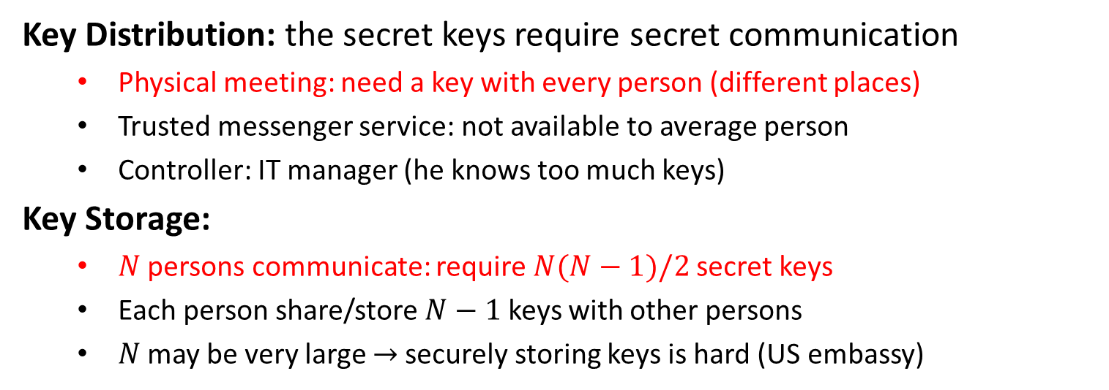
Drawbacks of Private-Key
Key Distribution: the secret keys require secret communication
Physical meeting: need a key with every person (different places)
Trusted messenger service: not available to average person
Controller: IT manager (he knows too much keys)
Key Storage:
$N$ persons communicate: require $N(N−1)/2$secret keys
Each person share/store $N−1$ keys with other persons
$N$ may be very large $→$securely storing keys is hard (US embassy)

Slide 8
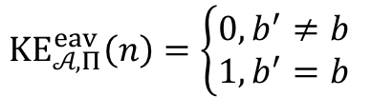
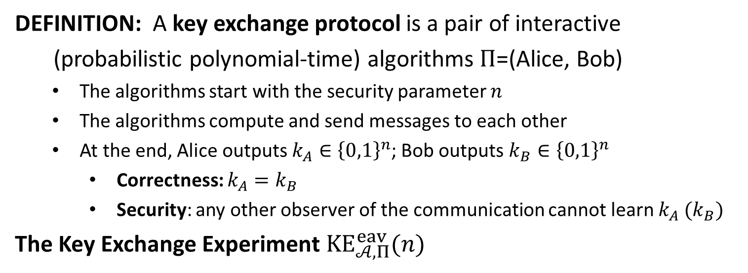



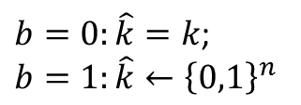


Key Exchange
DEFINITION: A key exchange protocol is a pair of interactive
(probabilistic polynomial-time) algorithms $Π$=(Alice, Bob)
The algorithms start with the security parameter $n$
The algorithms compute and send messages to each other
At the end, Alice outputs $k_{A}∈{\left\{0,1\right\}}^{n}$; Bob outputs $k_{B}∈{\left\{0,1\right\}}^{n}$
Correctness: $k_{A}=k_{B}$
Security: any other observer of the communication cannot learn $k_{A} (k_{B})$
The Key Exchange Experiment $KE_{𝒜,Π}^{eav}(n)$
$$\left(trans, k\right)←Π(n)$$
$$b←\{0,1\}$$
$b=0:\hat{k}=k$;
$$b=1:\hat{k}←{\left\{0,1\right\}}^{n}$$
$$(trans,\hat{k})$$
$$b′$$
$KE_{𝒜,Π}^{eav}\left(n\right)=\left\{\begin{aligned}0, b^{′}≠b \\ 1, b^{′}=b\end{aligned}\right.$
challenger
$$𝒜$$

Slide 9
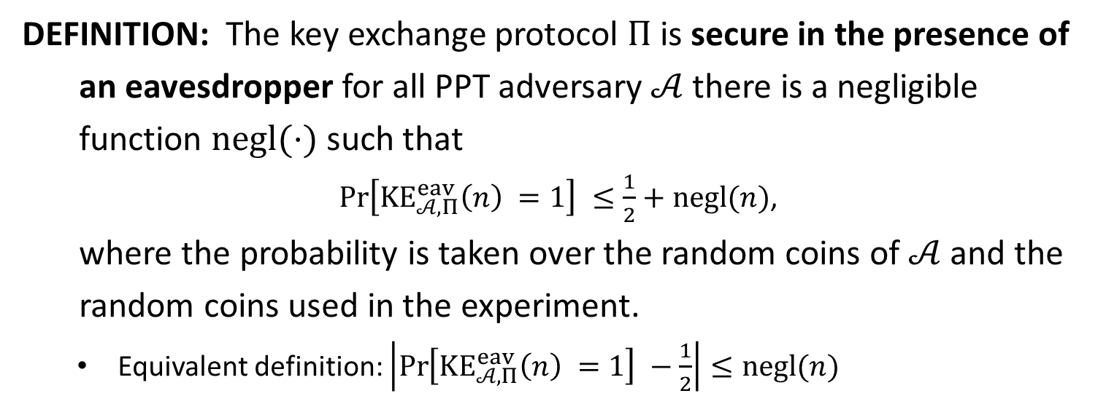
Security
DEFINITION: The key exchange protocol $Π$is secure in the presence of
an eavesdropper for all PPT adversary $𝒜$ there is a negligible
function $negl(⋅)$ such that
$\operatorname{Pr}\left[KE_{𝒜,Π}^{eav}\left(n\right) =1\right] ≤\frac{1}{2}+negl(n)$,
where the probability is taken over the random coins of $𝒜$ and the
random coins used in the experiment.
Equivalent definition: $\left|\operatorname{Pr}\left[KE_{𝒜,Π}^{eav}\left(n\right) =1\right] −\frac{1}{2}\right|≤negl(n)$

Slide 11

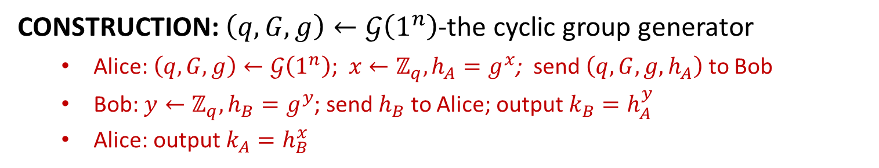

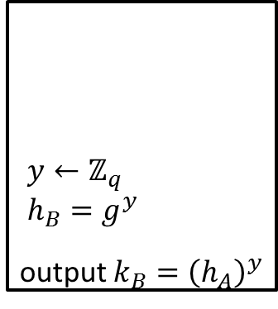
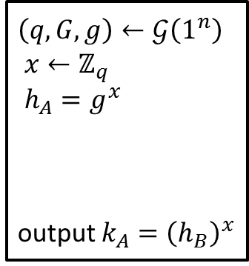
Diffie-Hellman Key Exchange
CONSTRUCTION: $\left(q,G,g\right)←𝒢\left(1^{n}\right)$-the cyclic group generator
Alice: $\left(q,G,g\right)←𝒢\left(1^{n}\right)$; $x←ℤ_{q}, h_{A}=g^{x}$; send $\left(q,G,g,h_{A}\right)$ to Bob
Bob: $y←ℤ_{q}, h_{B}=g^{y}$; send $h_{B}$ to Alice; output $k_{B}=h_{A}^{y}$
Alice: output $k_{A}=h_{B}^{x}$
$\left(q,G,g\right)←𝒢\left(1^{n}\right)$
$x←ℤ_{q}$
$h_{A}=g^{x}$
output $k_{A}={\left(h_{B}\right)}^{x}$
$y←ℤ_{q}$
$h_{B}=g^{y}$
output $k_{B}={\left(h_{A}\right)}^{y}$
$$(q,G,g,h_{A})$$
$$h_{B}$$
Alice
Bob
Correctness: $h_{A}^{y}=g^{xy}=h_{B}^{x}⇒k_{A}=k_{B}$ (A, B output the same key)

Slide 12
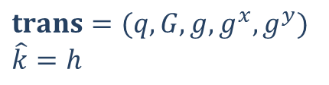
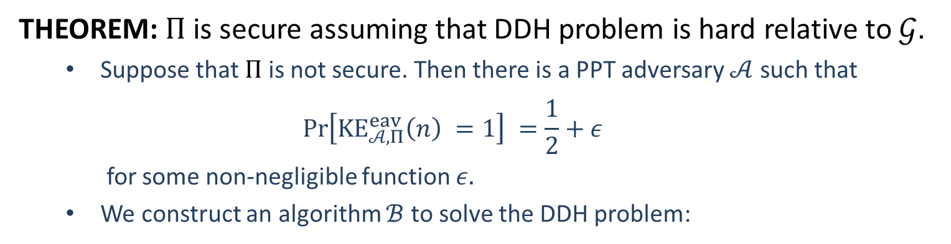

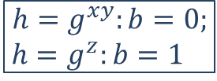






Security
THEOREM: $Π$ is secure assuming that DDH problem is hard relative to $𝒢$.
Suppose that $Π$ is not secure. Then there is a PPT adversary $𝒜$ such that
$$\operatorname{Pr}\left[KE_{𝒜,Π}^{eav}\left(n\right) =1\right] =\frac{1}{2}+ε$$
for some non-negligible function $ε.$
We construct an algorithm $ℬ$ to solve the DDH problem:
$$t=(q,G,g,g^{x},g^{y},h)$$
$h=g^{xy}$ or $h=g^{z}$
$$trans=(q,G,g,g^{x}, g^{y})$$
$$\hat{k}=h$$
$$(trans,\hat{k})$$
$$b^{′}$$
$$b′$$
$$ℬ$$
$$𝒜$$
$$h=g^{xy}:b=0;$$
$h=g^{z}:b=1$

Slide 13
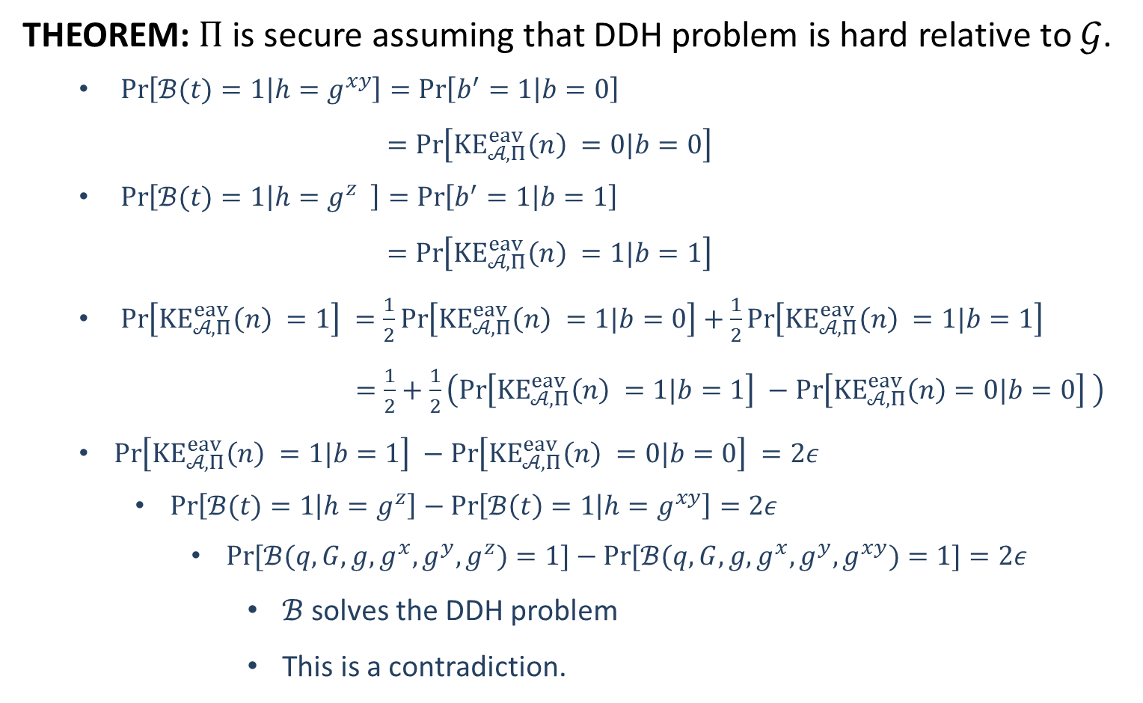
Security
THEOREM: $Π$ is secure assuming that DDH problem is hard relative to $𝒢$.
$\operatorname{Pr}\left[ℬ(t)=1 | h=g^{xy}\right]=\operatorname{Pr}\left[b^{′}=1 | b=0\right]$
$=\operatorname{Pr}\left[KE_{𝒜,Π}^{eav}\left(n\right) =0|b=0\right]$
$\operatorname{Pr}\left[ℬ(t)=1 | h=g^{z} \right]=\operatorname{Pr}\left[b^{′}=1 | b=1\right]$
$=\operatorname{Pr}\left[KE_{𝒜,Π}^{eav}\left(n\right) =1|b=1\right]$
$\operatorname{Pr}\left[KE_{𝒜,Π}^{eav}\left(n\right) =1\right] =\frac{1}{2}\operatorname{Pr}\left[KE_{𝒜,Π}^{eav}\left(n\right) =1|b=0\right]+\frac{1}{2}\operatorname{Pr}\left[KE_{𝒜,Π}^{eav}\left(n\right) =1|b=1\right]$
$=\frac{1}{2}+\frac{1}{2}\left(\operatorname{Pr}\left[KE_{𝒜,Π}^{eav}\left(n\right) =1|b=1\right] −\operatorname{Pr}\left[KE_{𝒜,Π}^{eav}\left(n\right)=0|b=0\right] \right)$
$\operatorname{Pr}\left[KE_{𝒜,Π}^{eav}\left(n\right) =1|b=1\right] −\operatorname{Pr}\left[KE_{𝒜,Π}^{eav}\left(n\right) =0|b=0\right] =2ε$
$\operatorname{Pr}\left[ℬ(t)=1 | h=g^{z}\right]−\operatorname{Pr}\left[ℬ\left(t\right)=1 | h=g^{xy}\right]=2ε$
$\operatorname{Pr}{[ℬ(q,G,g,g^{x},g^{y},g^{z})=1]}−\operatorname{Pr}{[ℬ(q,G,g,g^{x},g^{y},g^{xy})=1]}=2ε$
$ℬ$ solves the DDH problem
This is a contradiction.

Slide 14

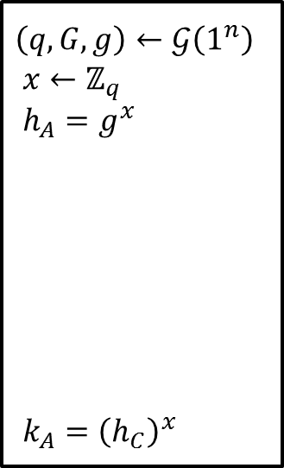



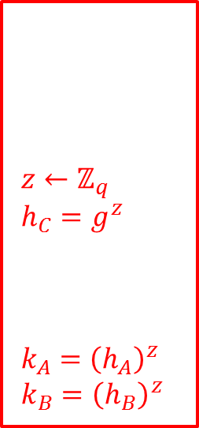

Man-in-the-middle attack
Diffie-Hellman key exchange requires an authenticated channel:
Modification to the communication should be detectable.
Otherwise, there is a man-in-the-middle attack.
Man-in-the-middle attack: A and B output different keys (known to C)
$\left(q,G,g\right)←𝒢\left(1^{n}\right)$
$x←ℤ_{q}$
$h_{A}=g^{x}$
${k_{A}=\left(h_{C}\right)}^{x}$
$z←ℤ_{q}$
$h_{C}=g^{z}$
$k_{A}={\left(h_{A}\right)}^{z}$
$k_{B}={\left(h_{B}\right)}^{z}$
$y←ℤ_{q}$
$h_{B}=g^{y}$
${k_{B}=\left(h_{C}\right)}^{y}$
$$q,G,g,h_{A}$$
$$q,G,g,h_{C}$$
$$h_{B}$$
$$h_{C}$$
Alice
Charlie
Bob

